Slide 1

_{Heart Attack Prediction}
BUAN.6356.006 – Business Analytics with R
Group - 16
Parthasarathi, Prriyamvradha (pxp220005)
Jawahar Vasagam, Premi (pxj220007)
Tallapally, Jahnavi (jxt200051)
Draksharam, Vishnu Paschyanti (vxd200023)
Farzana M B, Ashika (axf210029)

Slide 2
Objective
Heart disease has increased significantly over the past few years for various reasons, including the environment, food, and people's different lifestyle choices.
Our primary goal in this project is to identify the risk factors that significantly increase a person's likelihood of developing heart disease.
With this data, we can better understand how to use the items to improve our health, which also enables us to identify all probable causes of heart problems.
Notes:
To create our models, we utilized R, a static computation and graphical application. To comprehend our dataset and build a broad concept for subsequent research, we first studied the data. The variables we looked at, showed some correlations. Then, we built classification models using this data set, such as the decision tree model and logistic regression model, to determine whether someone with specific diagnostic parameters has a high risk of developing heart disease. We used 20% of the records as validation datasets and 80% of the records as training datasets for the decision tree model. We then plotted the decision tree and assessed it using the confusion matrix and curve. We also sample the training and validation datasets for the logistic regression model, compute the odds ratio, and assess the logistic regression model using the confusion matrix in ROC. The best model was chosen after thorough evaluation of each one.
The elements that are creating heart problems, how people are altering their habitats through time, and how to spot them before it's too late are what motivate us to work on this. By examining the diseases that are the main causes of death worldwide, we might calculate the death rates using the information supplied. By 2030, cardiovascular disease is expected to impact 44% of US adults, meaning that 92.1 million Americans should have had at least one kind of cardiovascular illness.

Slide 3
Data Description
The heart disease dataset, which was collected from Kaggle, serves as the main original dataset for this investigation. (https://www.kaggle.com/code/namanmanchanda/heart-attack-eda-prediction-90-accuracy/data).
The primary dataset, which includes one target variable and 13 predictor variables, was deemed sufficient, therefore no new areas were employed.
Each independent variables and that type of variables that is either numerical or categorical and the description of the variable has been described in the table to the right.

Slide 4
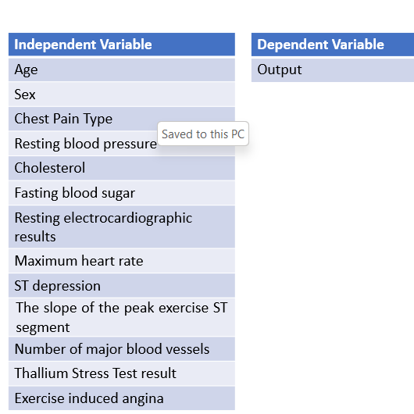
Independent and Dependent Variables

Slide 5
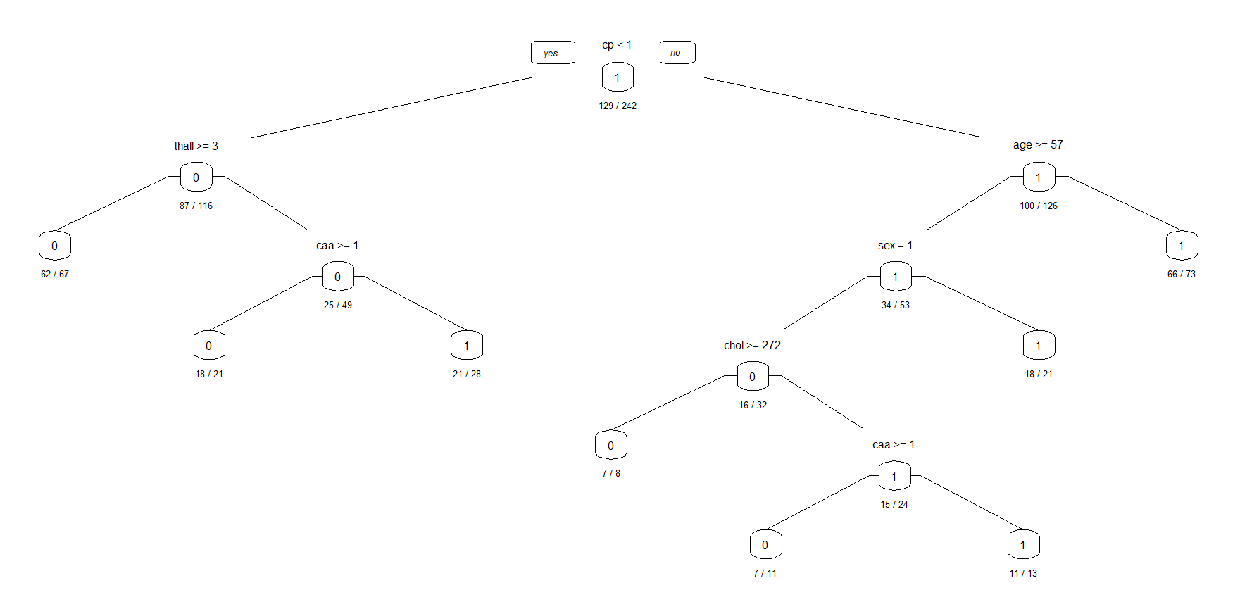
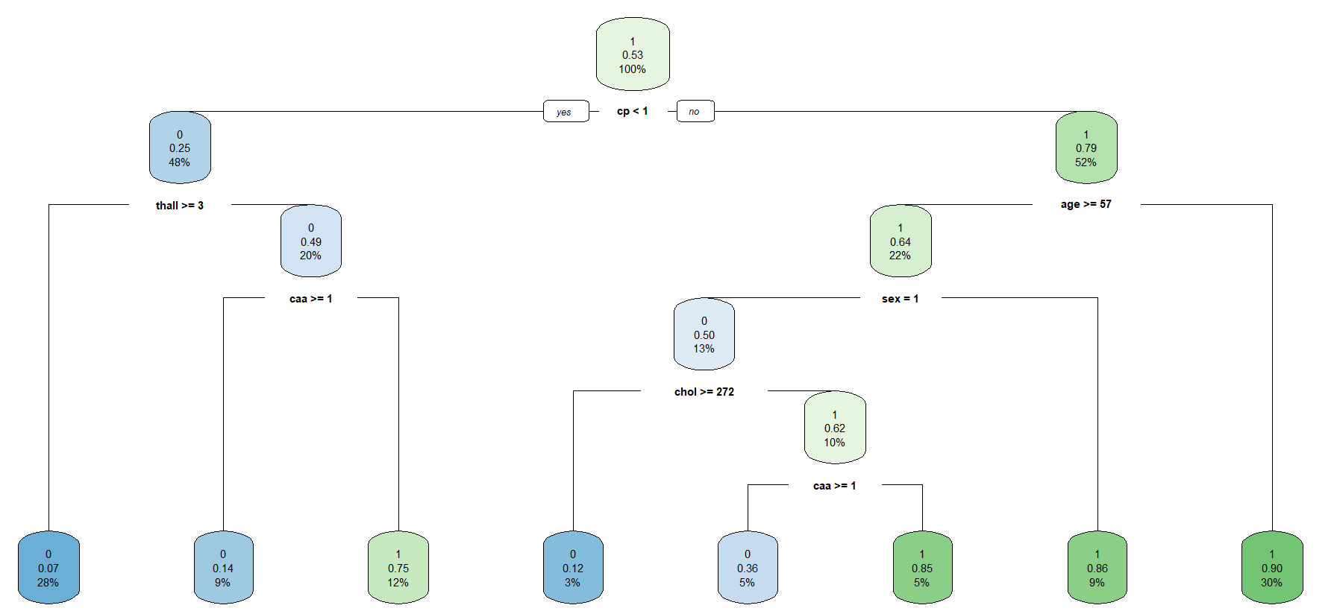
Decision Tree
We performed the decision tree classification analysis on our dataset. The dataset was split into training (80%) and validation data (20%) and ran the analysis. We used cp as the target variable and the outputs were based on whether the cp<1 and then went on to the other levels
Notes:
The decision tree is the most efficient and renowned classification and prediction method. A decision tree is a tree structure resembling a flow chart, in which each internal node indicates a test on an attribute, each branch shows the test's result, and each leaf node has a class label. From the decision tree we get the following rule with the most percentage cover of cases.

Slide 6
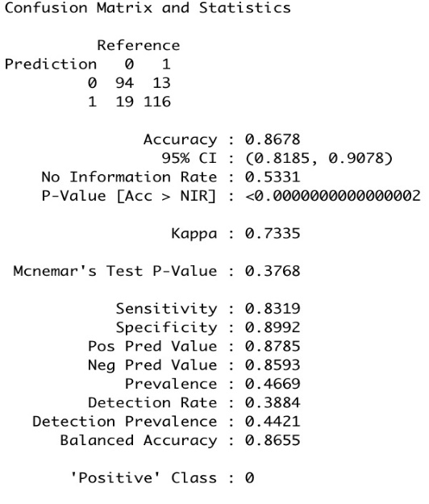
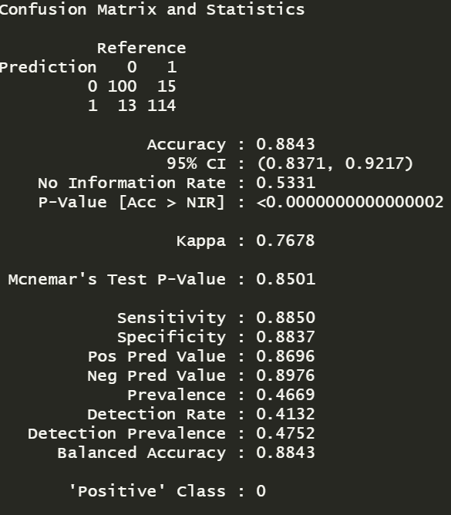
INTERPRETATION OF THE MODEL
From the first decision tree analysis, we get an accuracy of 86.78%
Pruning was then performed by removing the unwanted branches and prevent overfitting problem
This increased the accuracy and optimized the performance of the model
After pruning, the accuracy increases to 88.43%

Slide 7
Logistic Regression
We also performed logistic regression to compare the results with that of decision tree analysis
We use glm() function to run the regression and with summary() function, we gather the coefficients of regression and their p values respectively
The more significant variables are identified with the asterik marks. The more number of asteriks, the more significant that variable is
Significant variables have lower p values which turns out to be cp
We used the confusionMatrix() function to get the accuracy for the model
We get 83.61% as the accuracy and after logistic regression with StepAIC, we get accuracy as 80.33%
Notes:
It broadens the application of regression analysis to cases in which the response variable is binary and the primary outcome is categorical, as well as the proper regression analysis to carry out in those cases. Sex, cp, trestbps, ca, thalach, exang, slope are significant variables. The deviance using null illustrated how good the response will be predicted by using the model with intercept. The deviation of residual displays how well the model predicts the answer by using the predictors which are considered while working with them. While doing this process we can find out the error of measure. This tells us that residual deviance is the error of measure. Whenever there is in a smaller amount of residual deviance the good is the model’s predictive power. In the output we get the residual deviance smaller than the null deviance, or a logistic regression model has some predictive power, and the variables will have some explanatory power.
We choose the best model we can with all the important variables by using AIC. The residual deviation is less than the null variance though in the IC model, indicating some predictive potential for the r model.

Slide 8
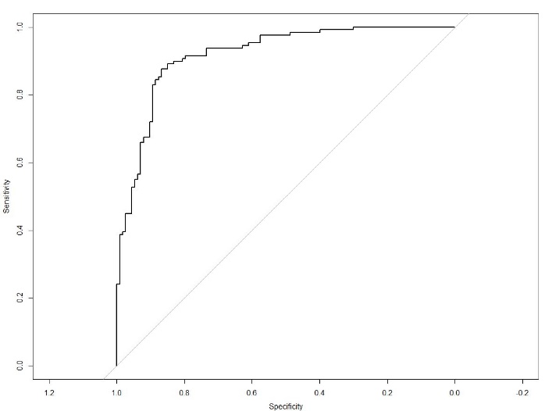
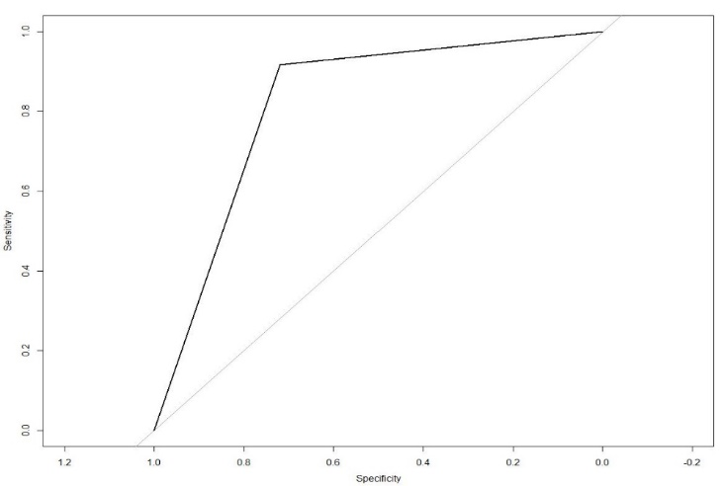
Model Evaluation – ROC Curve
We also ROC curves and get the area under the curves to visualize the performance of the models
We use plot.roc() function to plot the curves and use auc() function to get the area under the curves
The first curve is the ROC curve for the training dataset and the area under the curve is 0.9191
The second curve is the ROC curve for the validation dataset and the area under the curve is 0.8183
Notes:
We utilize the AUC which is area under the curve and ROC which is known as Receiver Operating Characteristics curves for the classification issue to evaluate or visualize the performance of the classifier problem. It is among the most crucial assessment matrices for assessing the effectiveness of any different classifiers. It can also be expressed as an AROC. The probability curve is called ROC, and the amount or measure of distinction is called AUC. It reveals how well the model can discriminate between classes. The model performs better at detecting 0 as 0 and 1 as 1 which will be higher the AUC. Let’s take an example on how the model is better at differentiating, as which of the model is more elevated AUC. A practical model has an AUC close to 1, which indicates that it has a strong level of separability. Our algorithm has the weakest metric of separability since its AUC is close to the 0. This indicates that the outcome is reversing. It predicts that zeros will be ones and ones will be zeros. Additionally, a model has absolutely no potential for class separation when AUC is 0.5.

Slide 9
Conclusion
We created and evaluated logistic regression and decision tree models and recorded the outcomes and performance measures for each.
We were 83.6% accurate with the regression model, and with the decision tree, we were 86.78% accurate. After pruning, we were able to improve the accuracy to 88.43%.
The decision tree approach is superior for our project's analysis as the accuracy is better than Logistic Regression
They also exhibit greater accuracy than the logistic regression model in this case and are simple to use and evaluate.
The constructed decision tree algorithm enabled us to pinpoint thal, ca, thalach, and cp as the most crucial heart attack predictors.
Analysed that Heart Attacks are not primarily caused by old age or cholesterol.
Notes:
This model may be used to determine whether a certain patient with a particular health profile is likely to have a heart attack. This model may be used to predict outcomes with greater precision and less error for larger populations. The model's predictions can be used as a starting point to enhance methods to research different medical aspects that may aid in preventing heart attacks. Similar projects may be created to analyse other vulnerable demographics and assist them in better serving society using analytics and various categorization methods.

Slide 10

THANK YOU

